Slide 1
Convolutional Neural Network for Fluid Dynamics
Sylle Hoogeveen
4445082
MSc Applied Mathematics

Slide 2





Outline
MOTIVATION
USE CASE
LITERATURE REVIEW
RESEARCH
QUESTIONS
METHODOLOGY

Slide 3

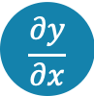
Motivation
NEURAL NETWORKS
Non-linear relations, latent representations, time evolution
NUMERICAL METHODS
Classical numerical solvers
and reduced order models
#
$$\frac{∂y}{∂x}$$
MATHEMATICAL MODELS
Approximate reality and desire for near real-time simulations
Notes:
The increase in complexity of mathematical models in an attempt to approximate reality and desire to have near real-time results, for example in medical image-guidance [1] or creating digital twins [2], have emphasized the need for fast simulations. Any implementation that requires quick design loops or many parameter runs. classical numerical solvers that are not completely implicit, mesh size and time step influence convergence and thus force longer computation time. Classical order reduction methods frequently rely on linear basis functions and depend on fixed domains due to discretization. Instead of using classical methods, neural networks can be used to learn non-linear relations, produce lower dimension representations and perform time evolution of physical phenomena governed by differential equations.

Slide 4
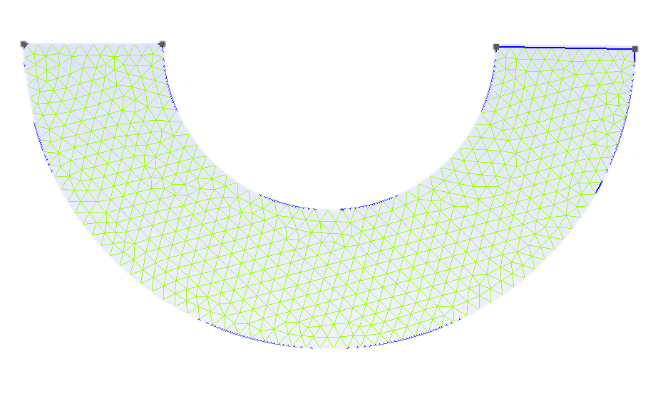
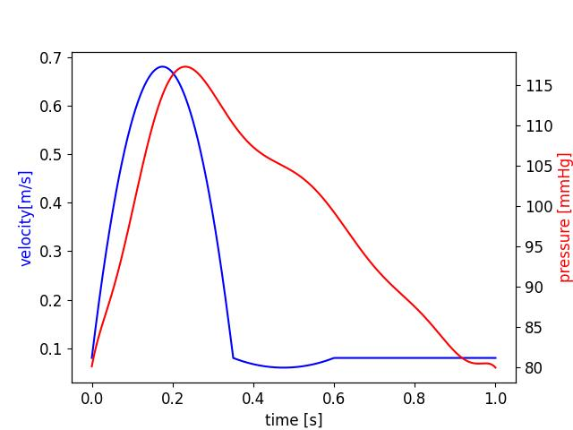
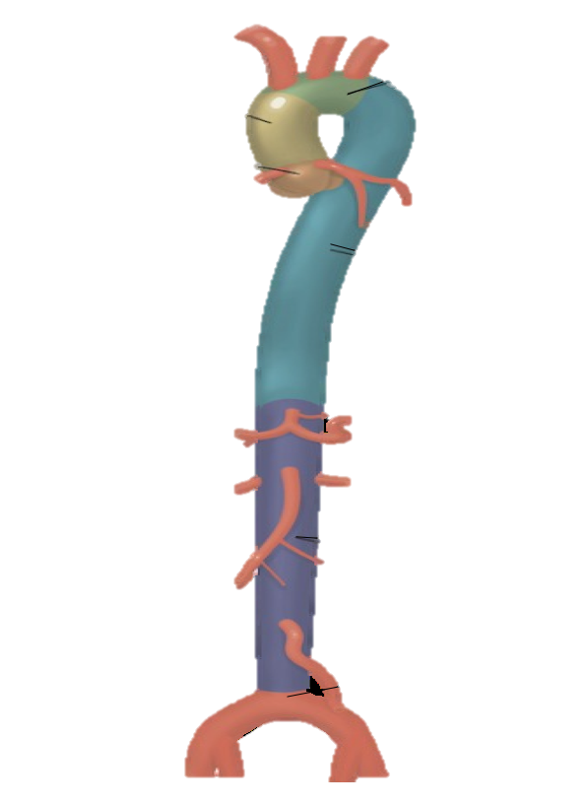
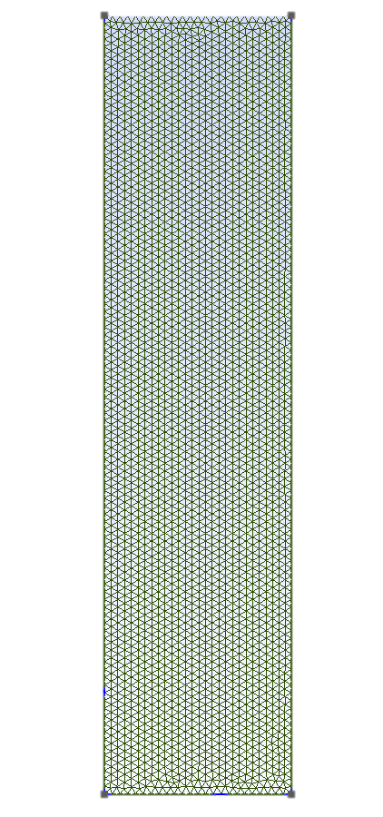
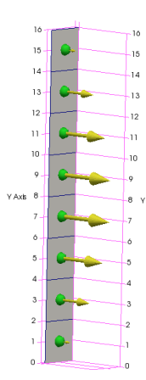
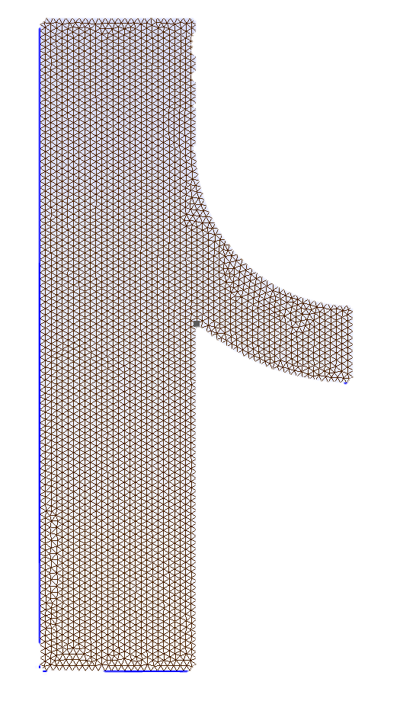
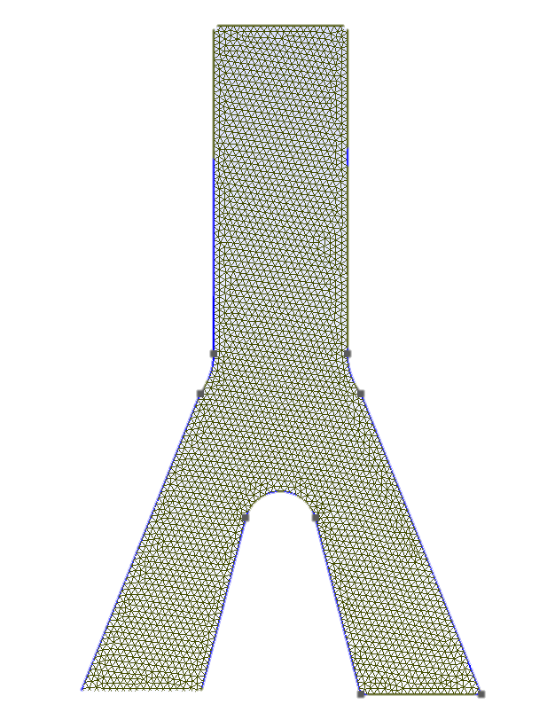
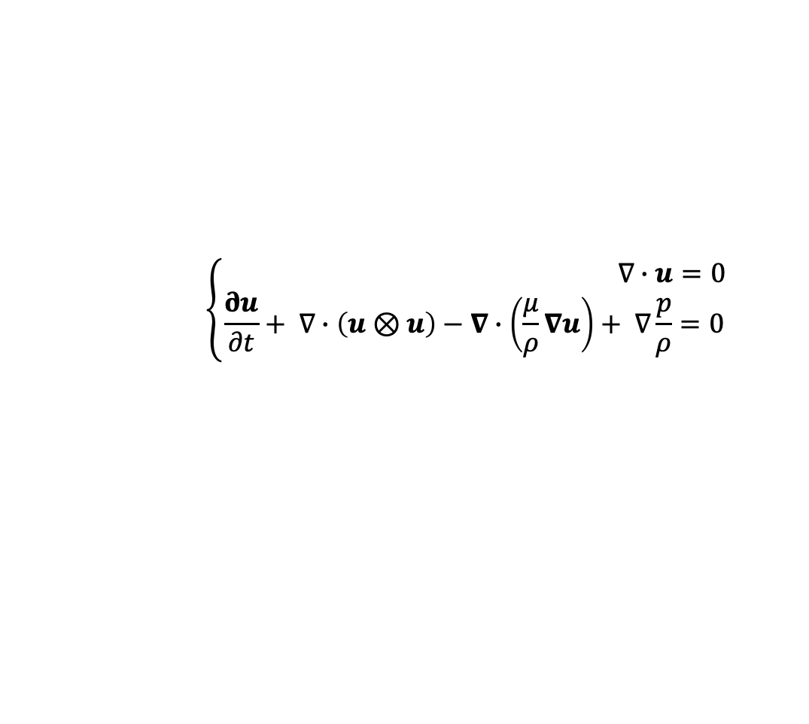
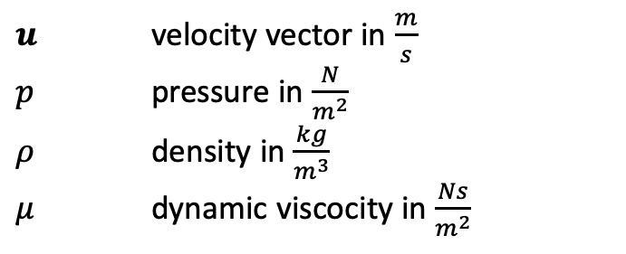
Use case: aortic blood flow
$$\left\{\begin{aligned} ∇∙u=0 \\ \frac{∂u}{∂t}+ ∇∙\left(u⊗u\right)−∇∙\left(\frac{μ}{ρ}∇u\right)+ ∇\frac{p}{ρ}=0\end{aligned}\right.$$
1
$u$ velocity vector in $\frac{m}{s}$
$p$ pressure in $\frac{N}{m^{2}}$
$ρ$ density in $\frac{kg}{m^{3}}$
$μ$ dynamic viscocity in $\frac{Ns}{m^{2}}$
2
3
Assumptions:
Newtonian
Rigid artery walls
One inlet and maximum 2 outlets
Fully developed velocity at inlet
4
Notes:
Cardiovascular modelling is an ideal use case for constructing a ML ROM. Classic numerical methods struggle to produce valid solutions in reasonable computational time in this domain due to their complex behaviour on multiple temporal and spatial scales. So the model problem is blood flow through the aorta during one heartbeat. Which I simulated by dividing the aorta in 4 segments, created timedependent boundary conditions and running a solver in OpenFoam.

Slide 5
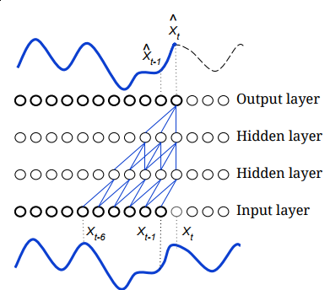
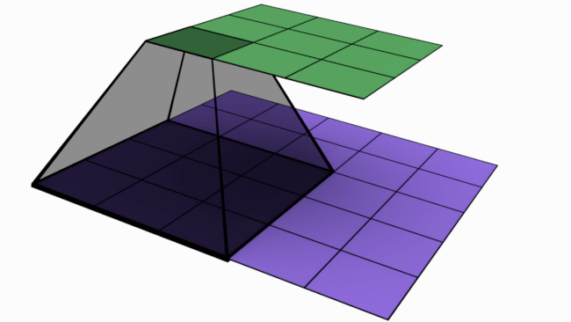
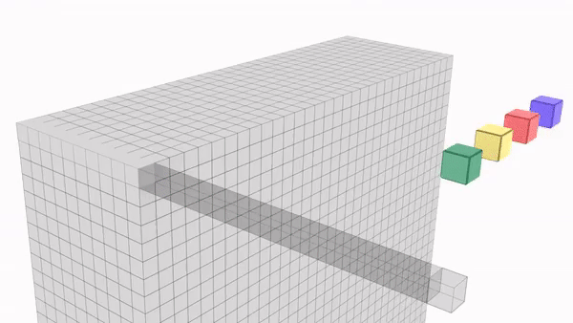
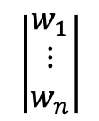
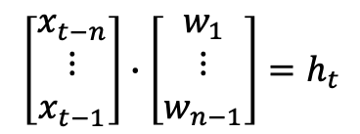
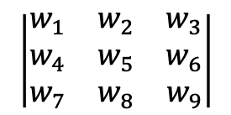
Machine Learning Framework
Convolutional Neural Networks
3x3 convolution
Pointwise convolution
Causal convolution (1D signal)
$$\left|\begin{matrix}w_{1} & w_{2} & w_{3} \\ w_{4} & w_{5} & w_{6} \\ w_{7} & w_{8} & w_{9}\end{matrix}\right|$$
$$\left|\begin{matrix}w_{1} \\ ⋮ \\ w_{n}\end{matrix}\right|$$
$$\left[\begin{matrix}x_{t−n} \\ ⋮ \\ x_{t−1}\end{matrix}\right]∙\left[\begin{matrix}w_{1} \\ ⋮ \\ w_{n−1}\end{matrix}\right]=h_{t}$$
Notes:
Different types of convolutions we will see in the literature review. Standard convolutions move over the input data and combine them depending on the filter, shown by the stencil below. Each filter shares weights, so the same weights are applied as the filter slides across the input data. On the contrary pointwise convolutions take the whole depth of the previous layer for one point and multiply them by weight vector. Used to control depth of next layer. Causal convolutions are used for timeseries forecasting, such that only data from previous timesteps is used to determine the next time step.

Slide 6
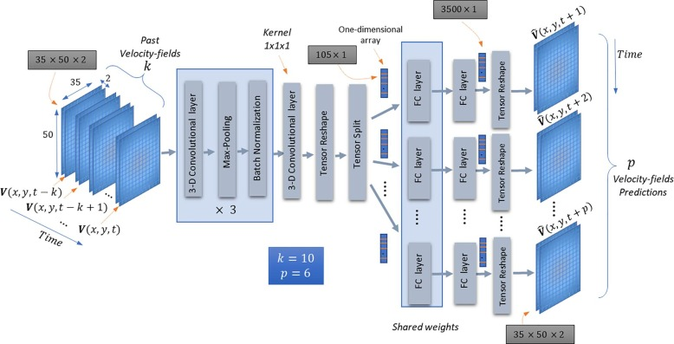
Machine Learning Framework
Convolutional Neural Networks
Lopez Martin- Synthetic jet [1]
Notes:
Synthetic jet simulations – complex flows formed by the periodic oscillation of a piston or membrane in a cavity, which is periodically forcing to leave and re-enter the flow into the cavity through a jet nozzle. Retrained on small set of cylinder flow → works. Simple rectangular domain, varying flow patterns.

Slide 7
Machine Learning Framework
Autoencoders
Notes:
Autoencoder is a network structure that uses a bottleneck, consecutive layers contain less reduce dimension. Produce latent space represenation.

Slide 8
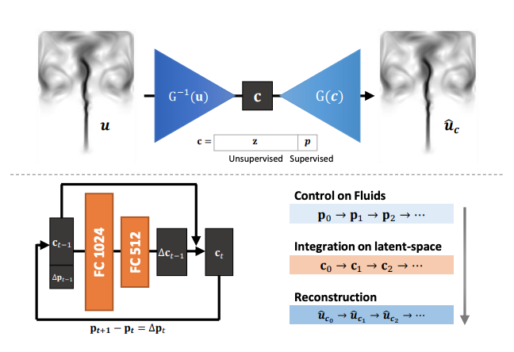
Machine Learning Framework
Autoencoders
Simpson - Forcing [2], Kim - Shallow [3], Kim - Deep fluids [4]
Notes:
Simple autoencoder (no convolutions) for systems under forcing, dynamics not in training data were not captured by ROM. Suggested using convolutional layers for high dimensional input.
First Kim et al. Shallow masked autoencoder, used a mask on the decoder to reflect local connectivity as in the central difference scheme of FDM → makes the network domain dependent.
Different Kim et al. Graphical implementation, 700x speedup. Reconstruction depended heavily on scenario's matching training data. Here they used a neural network for time evolution of the solution.

Slide 9
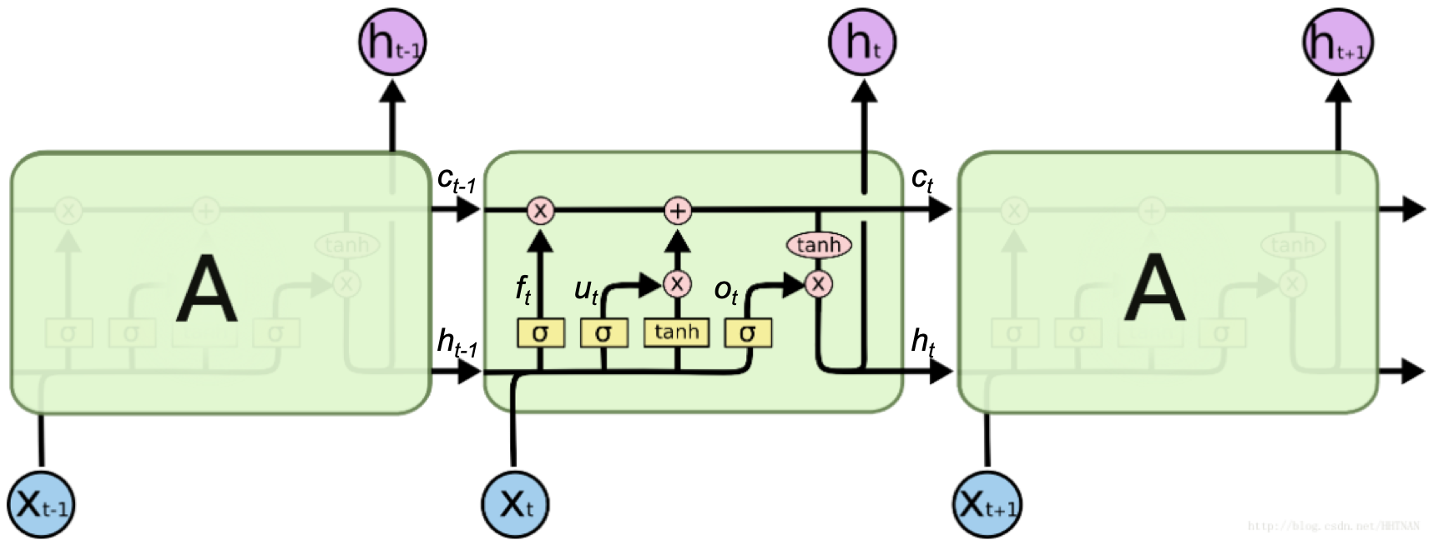
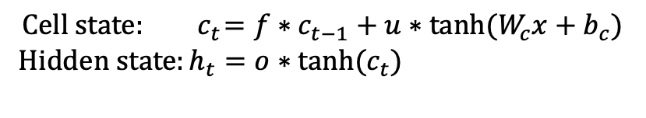
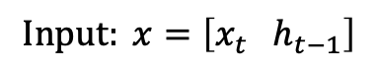
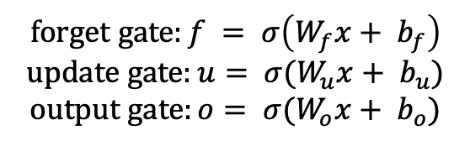
Machine Learning Framework
Recurrent Neural Networks – LSTM
$$Input: x=\left[x_{t} h_{t−1}\right]$$
$$forget gate:f = σ\left(W_{f}x+ b_{f}\right)$$
$$update gate:u= σ(W_{u}x+ b_{u})$$
$$output gate:o= σ(W_{o}x+ b_{o})$$
$$Cell state: { c}_{t}=f∗c_{t−1}+u∗tanh⁡(W_{c}x+b_{c})$$
$Hidden state:h_{t}=o∗tanh(c_{t})$
Simpson - Forcing [2], Pawar - Vortex [5], Hu - Floods [6]
Notes:
Could also use an recurrent neural network for time series. These networks have ‘memory’ (cell state) to retain information from previous inputs. LSTM unit: The new cell state is computed by multiplying the previous cell state by what was learned to forget (the forget gate) and adding this to what was learned to be remembered. The new hidden state is computed by the cell state scaled between [-1,1] by tanh function multiplied by what was learned to be exposed to the hidden state (output gate). sigmoid function which returns values between 0 and 1, killing input close to 0 and letting input close to 1 pass nearly unchanged.
Used in combination with classic ROM (POD + Galerkin → Vortex-merging, improved accuracy compared to pure data-driven, suggested extension by more significant variation between train and test data.
POD+SVD spatial-temporal distribution of floods)
and ML (autoencoder → system under forcing).

Slide 10
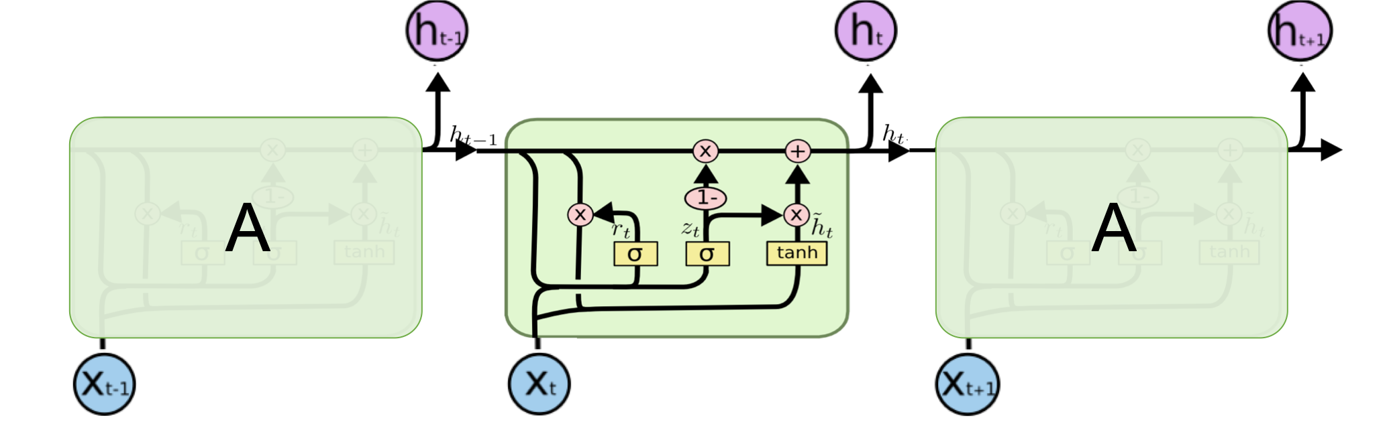
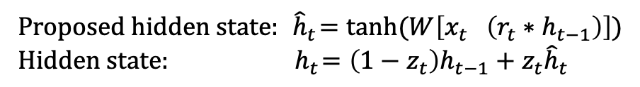
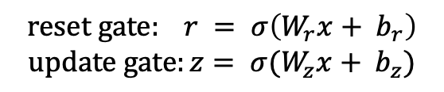
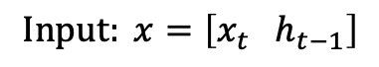
Machine Learning Framework
Recurrent Neural Networks – GRU
$$Input: x=\left[x_{t} h_{t−1}\right]$$
$$reset gate: r = σ\left(W_{r}x+ b_{r}\right)$$
$$update gate:z= σ(W_{z}x+ b_{z})$$
$Proposed hidden state: { \hat{h}}_{t}=tanh⁡(W\left[x_{t} \left(r_{t}∗h_{t−1}\right)\right])$
$Hidden state:{ h}_{t}=\left(1−z_{t}\right)h_{t−1}+z_{t}{\hat{h}}_{t}$
Wu - Cylinder flow[7], Jamil - Bloodflow characteristics [8]
Notes:
Or GRU’s, which only have 2 gates and thus less complex structure, computationally more efficient proven to have comparable performance to LSTM. First a proposed new hidden state is computed by multiplying the old hidden state with the reset gate, concatenating this with the new part of the sequence and scaling between [-1,1] with the tanh function. Thereafter, the actual new hidden state is computed by taking a linear sum between the previous hidden state and the proposed new hidden state, in which the update gate determines how much of the hidden state is updated
Used in combination with classic ROM, flow past cylinder (simple rectangular domain with obstacle) → outperformed (also LSTM) by causal convolutions. TCN has five times fewer parameters than LSTM and three times fewer than GRU approximately
For predicting bloodflow characteristics (spartial sequence) GRU best overal accuracy but outperformed on specific characteristics by NN and LSTM unit

Slide 11
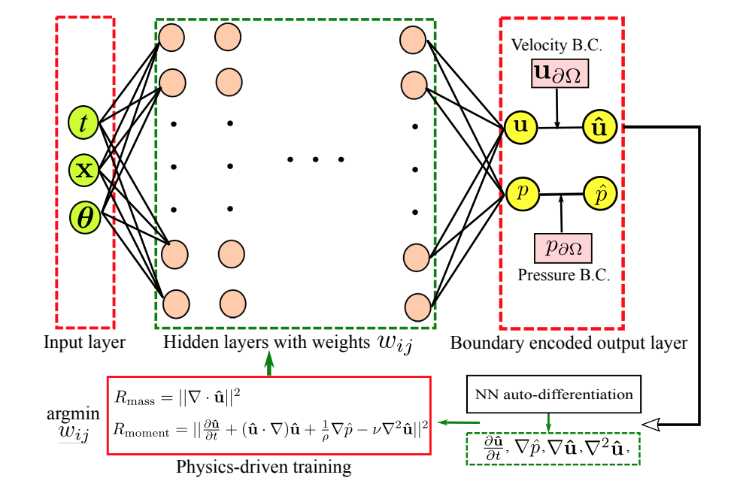
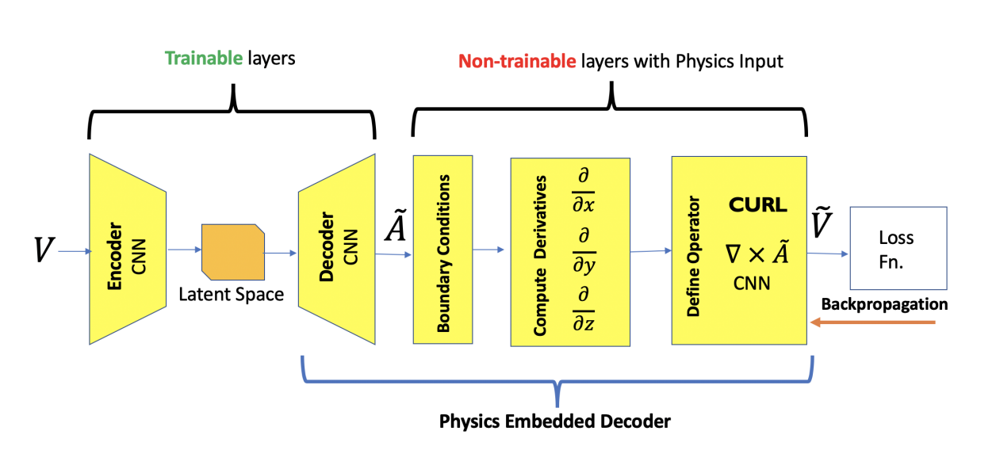
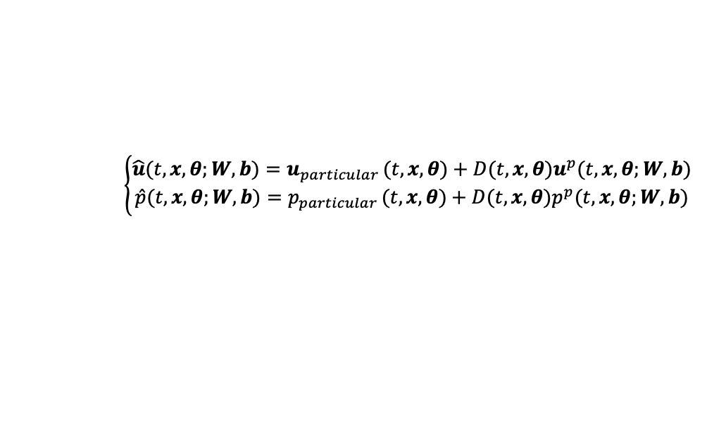
Machine Learning Framework
Physics informed networks
$L_{physics}= {|\left|∇∙u\right||}_{2}+{\left\|\frac{∂u}{∂t}+\left(u∙∇\right)u+\frac{1}{p}∇p−υ∇^{2}u\right\|}_{2}$
$L_{stream}= λ_{u}{|\left|u_{c} − ∇×G\left(c\right)\right||}_{1}+λ_{∇u}{|\left|∇u_{c} −∇(∇×G\left(c\right))\right||}_{1}$
$$\left\{\begin{aligned}\hat{u}(t,x,θ;W,b)=u_{particular }(t,x,θ)+D{(t,x,θ)u}^{p}(t,x,θ;W,b) \\ \hat{p}(t,x,θ;W,b)=p_{particular }(t,x,θ)+D(t,x,θ)p^{p}(t,x,θ;W,b)\end{aligned}\right.$$
Kim - Deep fluids[4], Mohan - Hard enforcing [9], Sun - Data-free [10]
Notes:
Soft enforcing: incorporating PDE in loss function. Stream function = vector potential is divergence free by construction. Curl of stream function is velocity field.
Hard enforcing: Learn vector potential from latent space representation. Enforced periodic BC with numerical stencil and ghostcells. Compute spatial derivatives by non-trainable CNN kernels that represent finite difference stencil. Compute curl of vector potential to obtain velocity field. Loss function is purely data driven. No total conservation of mass (discretization error) but less than without hard physical constaints.
Data-free model → Blood flow (pipe, stenosis, aneurysm) purely data driven is slightly more accurate (but need for simulation data, to calculate loss). Only soft physical constraints gave violation of no-slip wall condition. Only implemented steady state dirichlet BC.

Slide 12
Summary
X
Different flow patterns
VARIATIONS
X
No variation in geometries
INSIGHTS
X
Convolutional Neural Network
REDUCING ORDER
X
Autoencoder with convolutional layers
TIME EVOLUTION
X
NN, causal CNN, RNN with LSTM or GRU
PHYSICS
X
Pure data-driven highly dependent on training data
X
Hard, soft or hybrid enforcing of physics could increase generalizability
Notes:
Simple geometries (rectangular) but different flow patterns
Two options for general architecture: CNN or CNN+Autoencoder
Many options for time evolution: NN, LSTM, GRU, CNN
Purely datadriven models are highly dependent on training data set because lack connectivity with physics
Hard/soft or combination of enforcing physics to increase generalizability

Slide 13

“What is possible in terms of generalizability, whilst retaining accuracy, for time-dependent cardiovascular simulations with use of the state-of-the-art machine learning techniques?”
Network Architecture
BC & Material parameters
Computational domain
Robustness
Notes:
Which ML network architecture can predict consecutive time steps of time-dependent flow the most accurate?
Can the network produce accurate results for a range of physically relevant boundary conditions and material parameters?
How much can computational domains differ while retaining accuracy?
How robust is the network in terms of image resolution and time stepsize?

Slide 14
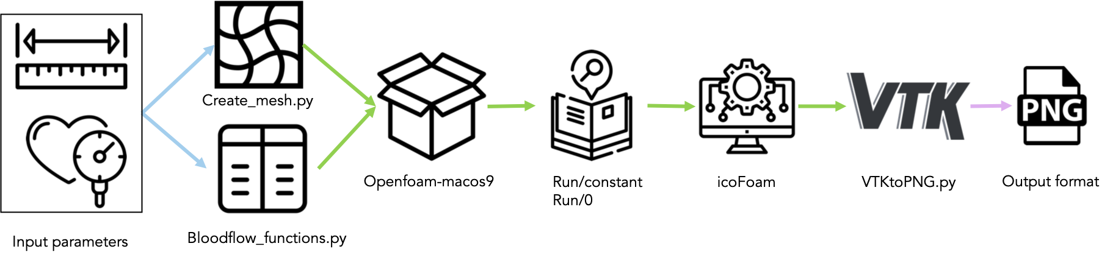
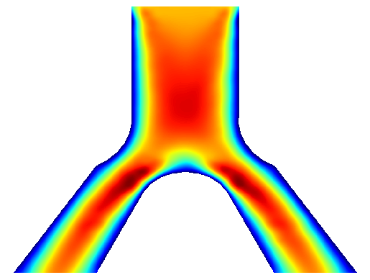
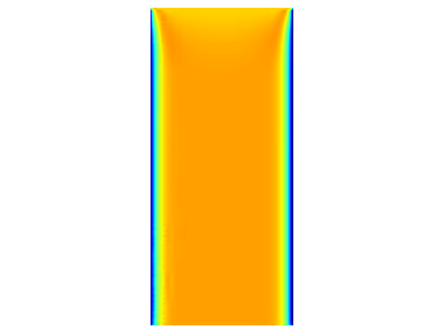
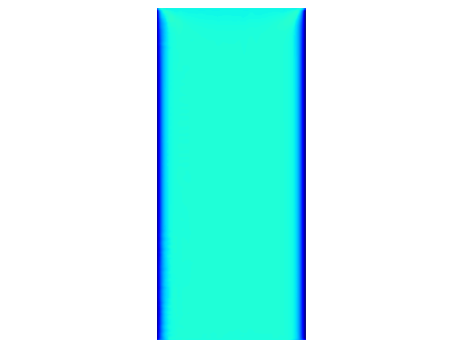
Methodology
Data Generation
Scenario
Channel width
(2nd channel width)
Peak inlet velocity
Peak outlet pressure(s)
Kinematic viscosity

Slide 15
Methodology
Future steps
Try to combine models or train new model for all scenario’s?
Train network for each ‘scenario’
STEP 2
STEP 4
STEP 1
STEP 3
STEP 5
Test different architectures
Introduce variations in geometry
Test final model on image resolution – time step relation
Notes:
Vary boundary conditions and material parameters in physically relevant range
Slight variations in geometry (channel width)
Introduce alterations in geometry; aneurysm or stenosis?

Slide 16
References
[1] Manuel Lopez-Martin, Soledad Le Clainche, and Belen Carro. “Model-free short-term fluid dynamics estimator with a deep 3D-convolutional neural network”. In: Expert Systems with Applications 177 (2021). issn: 09574174. doi: 10.1016/j.eswa.2021.114924
[2] Thomas Simpson, Nikolaos Dervilis, and Eleni Chatzi. “Machine Learning Approach to Model Order Reduction of Nonlinear Systems via Autoencoder and LSTM Networks”. In: Journal of Engineering Mechanics 147 (10 2021). issn: 0733-9399. doi: 10.1061/(asce)em.1943- 7889.0001971.
[3] Youngkyu Kim et al. “A fast and accurate physics-informed neural network reduced order model with shallow masked autoencoder”. In: Journal of Computational Physics 451 (2022). issn: 10902716. doi: 10.1016/j.jcp.2021.110841.
[4] Byungsoo Kim et al. “Deep Fluids: A Generative Network for Parameterized Fluid Simulations”. In: Computer Graphics Forum 38 (2 May 2019), pp. 59–70. issn: 14678659. doi: 10.1111/cgf.13619.
[5] Suraj Pawar et al. “Model fusion with physics-guided machine learning: Projection-based reducedorder modeling”. In: Physics of Fluids 33 (6 2021). issn: 10897666. doi: 10.1063/5.0053349.
[6] R. Hu et al. “Rapid spatio-temporal flood prediction and uncertainty quantification using a deep learning method”. In: Journal of Hydrology 575 (Aug. 2019), pp. 911–920. issn: 00221694. doi: 10.1016/j.jhydrol.2019.05.087
[7] Pin Wu et al. “Data-driven reduced order model with temporal convolutional neural network”. In: Computer Methods in Applied Mechanics and Engineering 360 (2020), p. 112766. issn: 0045-7825. doi: https://doi.org/10.1016/j.cma.2019.112766. url: https://www.sciencedirect.com/science/article/pii/S0045782519306589
[8] Ishat Raihan Jamil and Mayeesha Humaira. “Modeling and Predicting Blood Flow Characteristics through Double Stenosed Artery from Computational Fluid Dynamics Simulations using Deep Learning Models”. In: International Journal of Advanced Computer Science and Applications 13.1 (2022). issn: 2158-107X. doi: 10.14569/ijacsa.2022.0130197. url: http://dx.doi.org/10.14569/IJACSA.2022.0130197.
[9] Arvind Mohan et al. “Embedding Hard Physical Constraints in Neural Network Coarse-Graining of 3D Turbulence”. (Jan. 2020)
[10]Luning Sun et al. “Surrogate modeling for fluid flows based on physics-constrained deep learning without simulation data”. In: Computer Methods in Applied Mechanics and Engineering 361 (2020), p. 112732. issn: 0045-7825. doi: https://doi.org/10.1016/j.cma.2019.112732. url: https://www.sciencedirect.com/science/article/pii/S004578251930622X

